Slide 1
Titanic Dataset Analysis

Slide 2
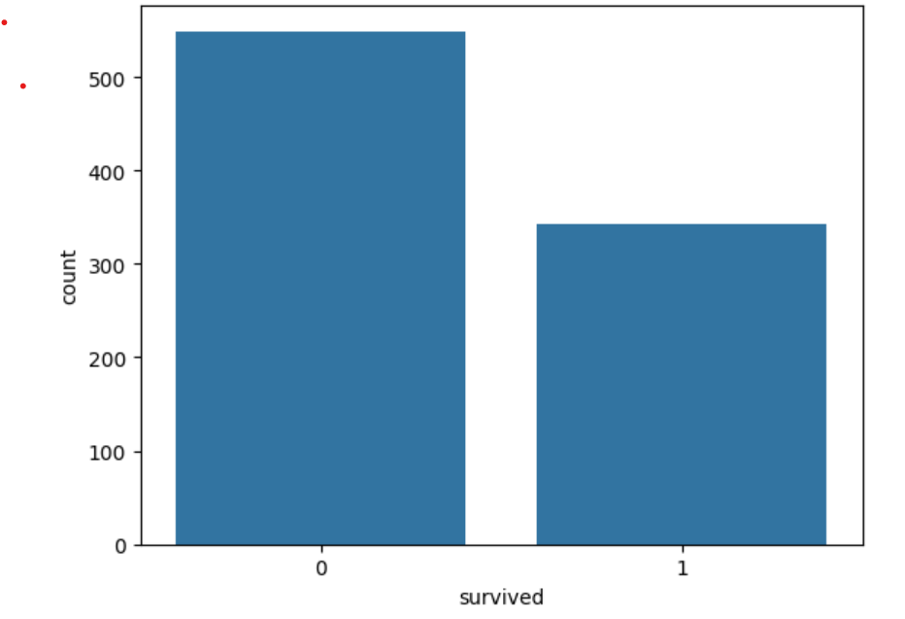
Overall Survival Distribution
Out of a total of 891 passengers, 549 passengers did not survive, while only 342 passengers survived.
This indicates that the majority of passengers did not survive, reflecting a relatively low overall survival rate.

Slide 3
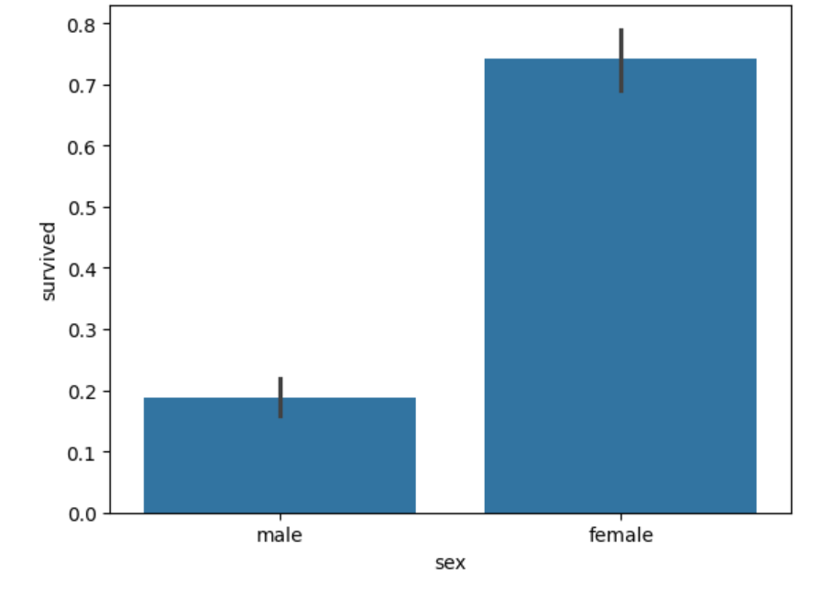
Gender-wise Survival Distribution
Female passengers had a significantly higher survival rate compared to male passengers.
This indicates that gender played a major role in survival, with males experiencing much lower survival rates.

Slide 4
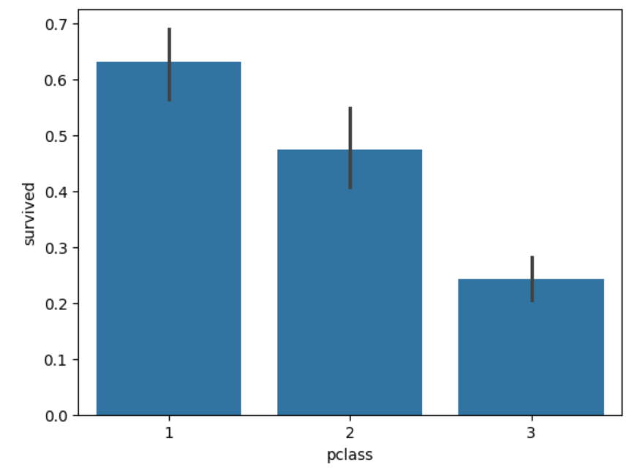
Survival Rate by Passenger Class
First-Class passengers had the highest survival rate compared to second and third-class passengers.
The survival rate decreases as the passenger class lowers, with third-class passengers having the lowest survival rate.

Slide 5
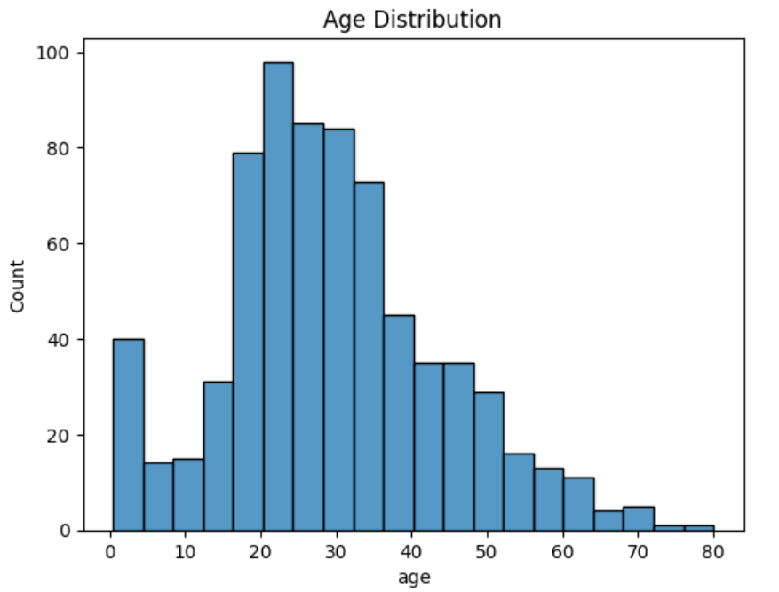
Age Distribution of Passengers
Most passengers were between 20 to 40 years, indicating a majority of young to middle-aged individuals.
There were relatively fewer elderly passengers, while a small proportion of children were also present on board.

Slide 6
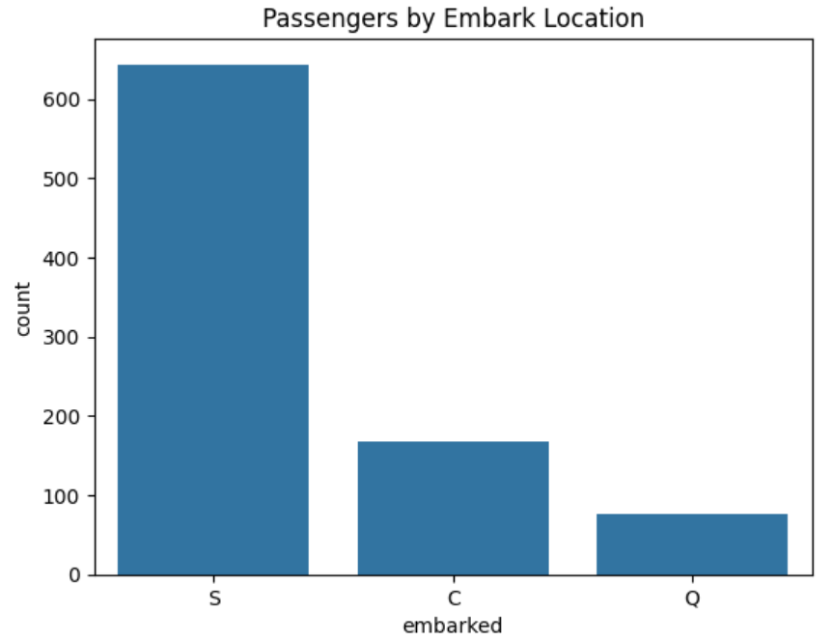
Passengers Distribution by Embarkation Location
The majority of passengers boarded from Southampton, making it the primary embarkation point.
A smaller number of passengers embarked from Cherbourg and Queenstown, indicating lower passenger traffic from these locations.

Slide 7
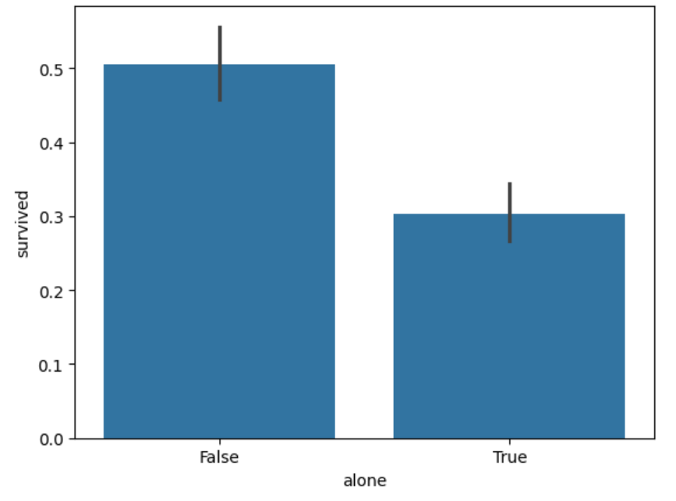
Family Impact on Survival
Passengers traveling with family had a higher survival rate compared to those traveling alone.
The data suggests that being accompanied by family members positively influenced the chances of survival.

Slide 8
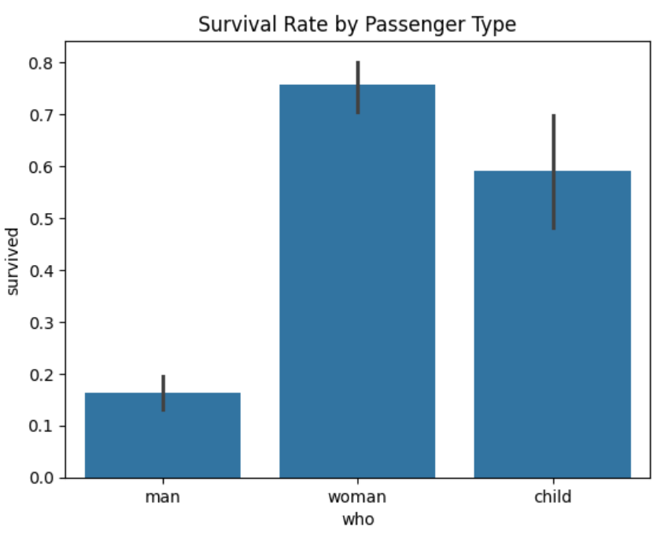
Survival Rate by Passenger Type
Women and children exhibited higher survival rates compared to men.
The data indicates that passenger type significantly influenced survival, with men having the lowest survival rate.

Slide 9
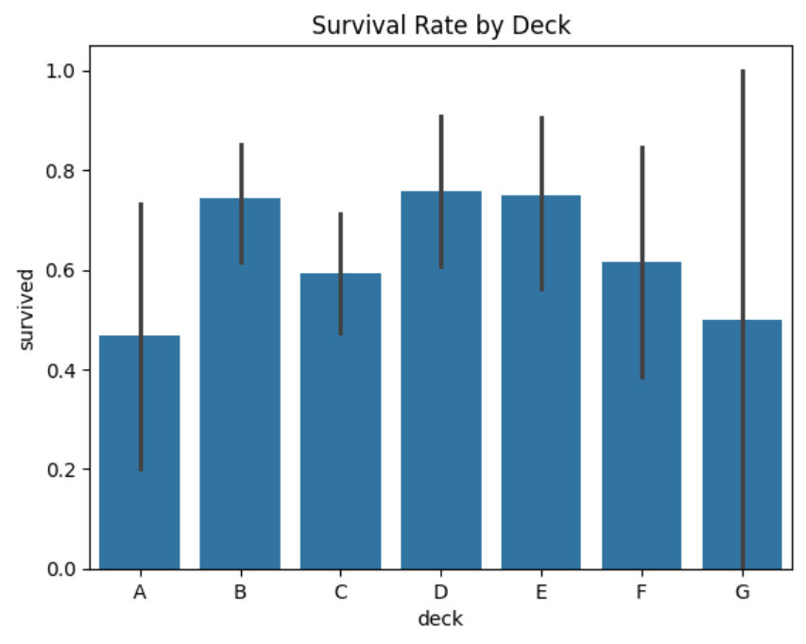
Survival Rate by Deck Level
Passengers located on higher decks, such as Deck B and C, exhibited higher survival rates.
Lower deck levels showed comparatively lower survival rates, indicating that deck location influenced survival chances.

Slide 10
Summary
Survival was influenced by multiple factors such as gender, class, age, family presence, and deck level.
Female passengers, children, and first-class passengers had higher survival rates.
Male passengers, individuals travelling alone, and third-class passengers had lower survival chances.
Overall, both social factors and passenger location played a key role in survival.

Slide 11
THANK YOU

